Slide 1

Team South Hall presents…
Roomba Home Defense System
(R.H.D.S)
By Jared Crow, Matthew Killy, and Sam Kundt
Notes:
Jared

Slide 2
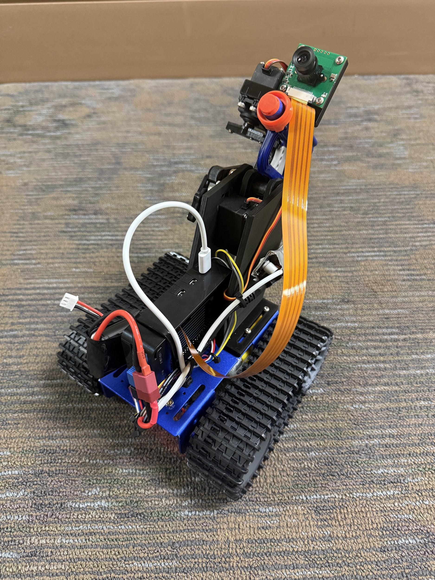
BACKGROUND
Need for safety in your home even when absent.
Unlike other systems such as RING doorbells or Wi-Fi cameras need user intervention, this is autonomous and no user intervention required.
Basically a roomba, security camera, and a taser/pepper spray combined.
For our assignment, we used a harless form of
defense (a NERF blaster) to simulate more effective
means.
Patrols until it finds a face to target, fires at target, and then resumes patrolling.
Uses a pre-trained OpenCV library to detect faces.
Notes:
Sam

Slide 3
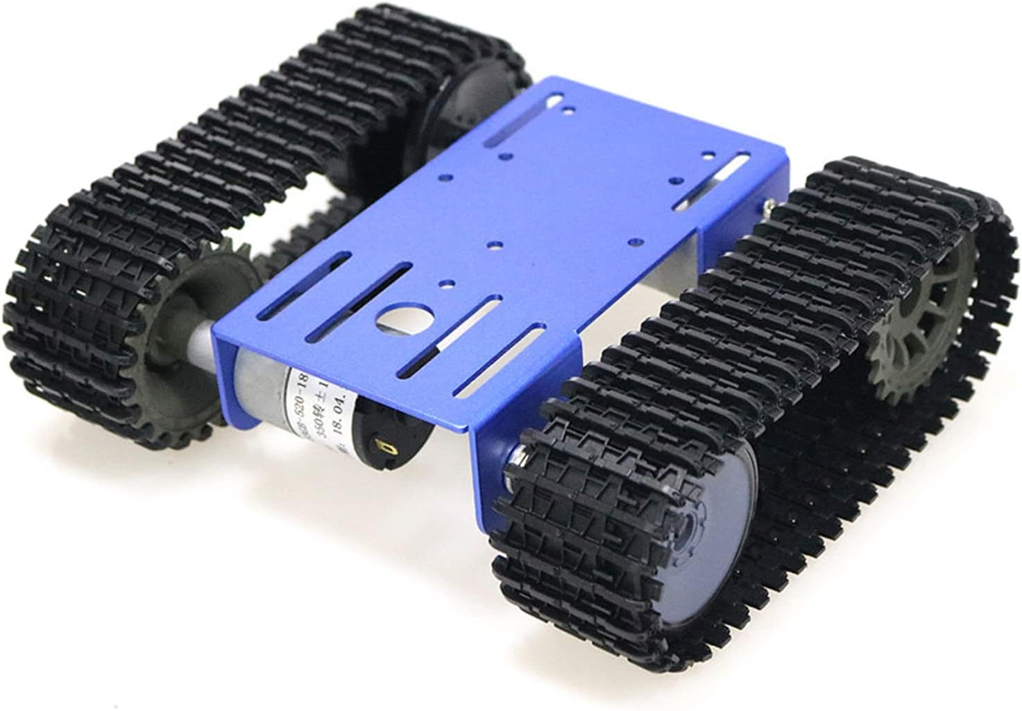
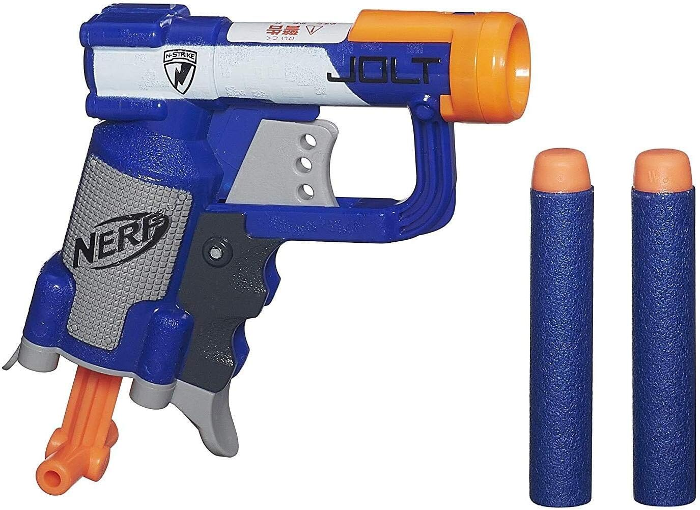
Components Used (1)
2WD Tank Robot Chassis
Chosen because it is easy to control and steer.
https://a.co/d/gzPkbQN
NERF Jolt Blaster
Is single shot.
Chosen because it is non-lethal, and would fit well in the small scale we were working with.
https://a.co/d/1Do93lz
Notes:
Matthew

Slide 4
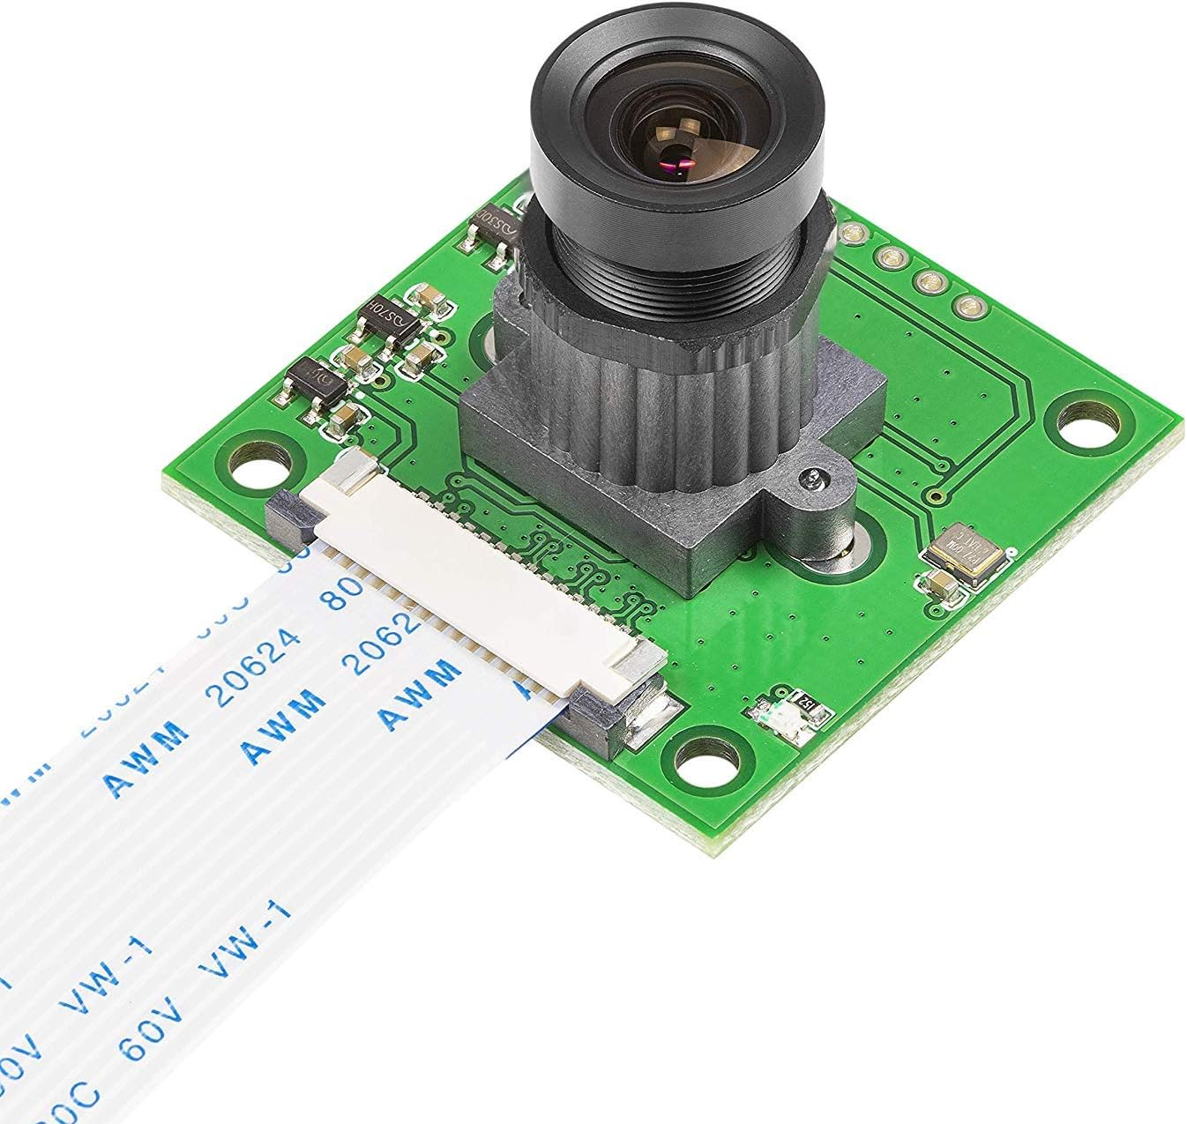
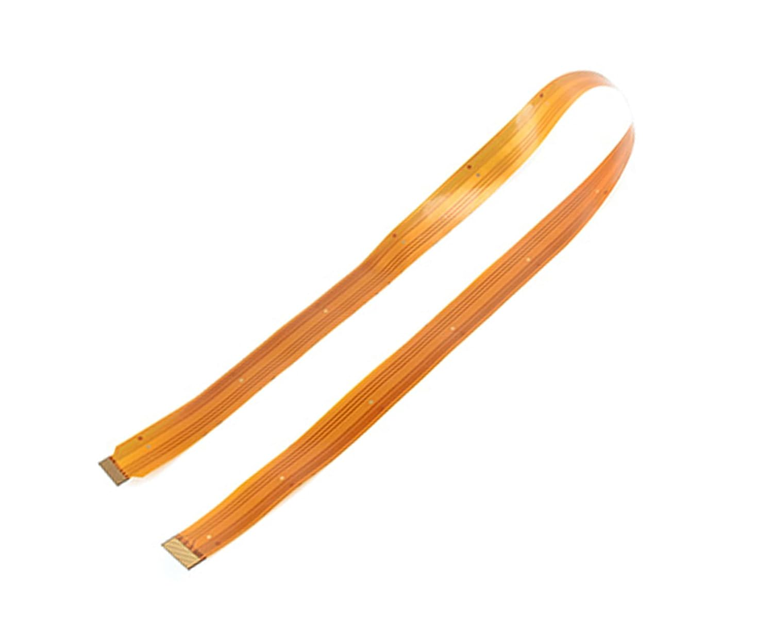
Components Used (2)
Arducam Camera
Chosen because it's affordable and designed to work with Pi 5.
https://a.co/d/a1L4c8M
CSI Flexible Camera Cable
Purchased because the cable included with the camera was too short.
https://a.co/d/h7Dm9E5
Notes:
Matthew

Slide 5
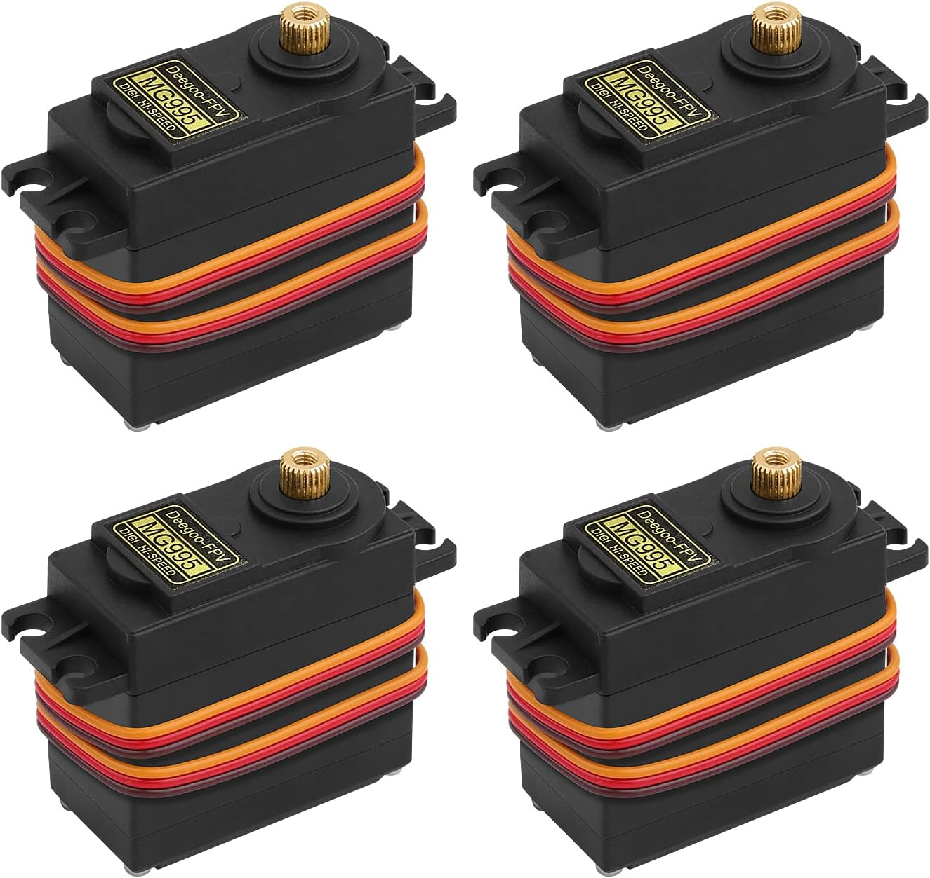
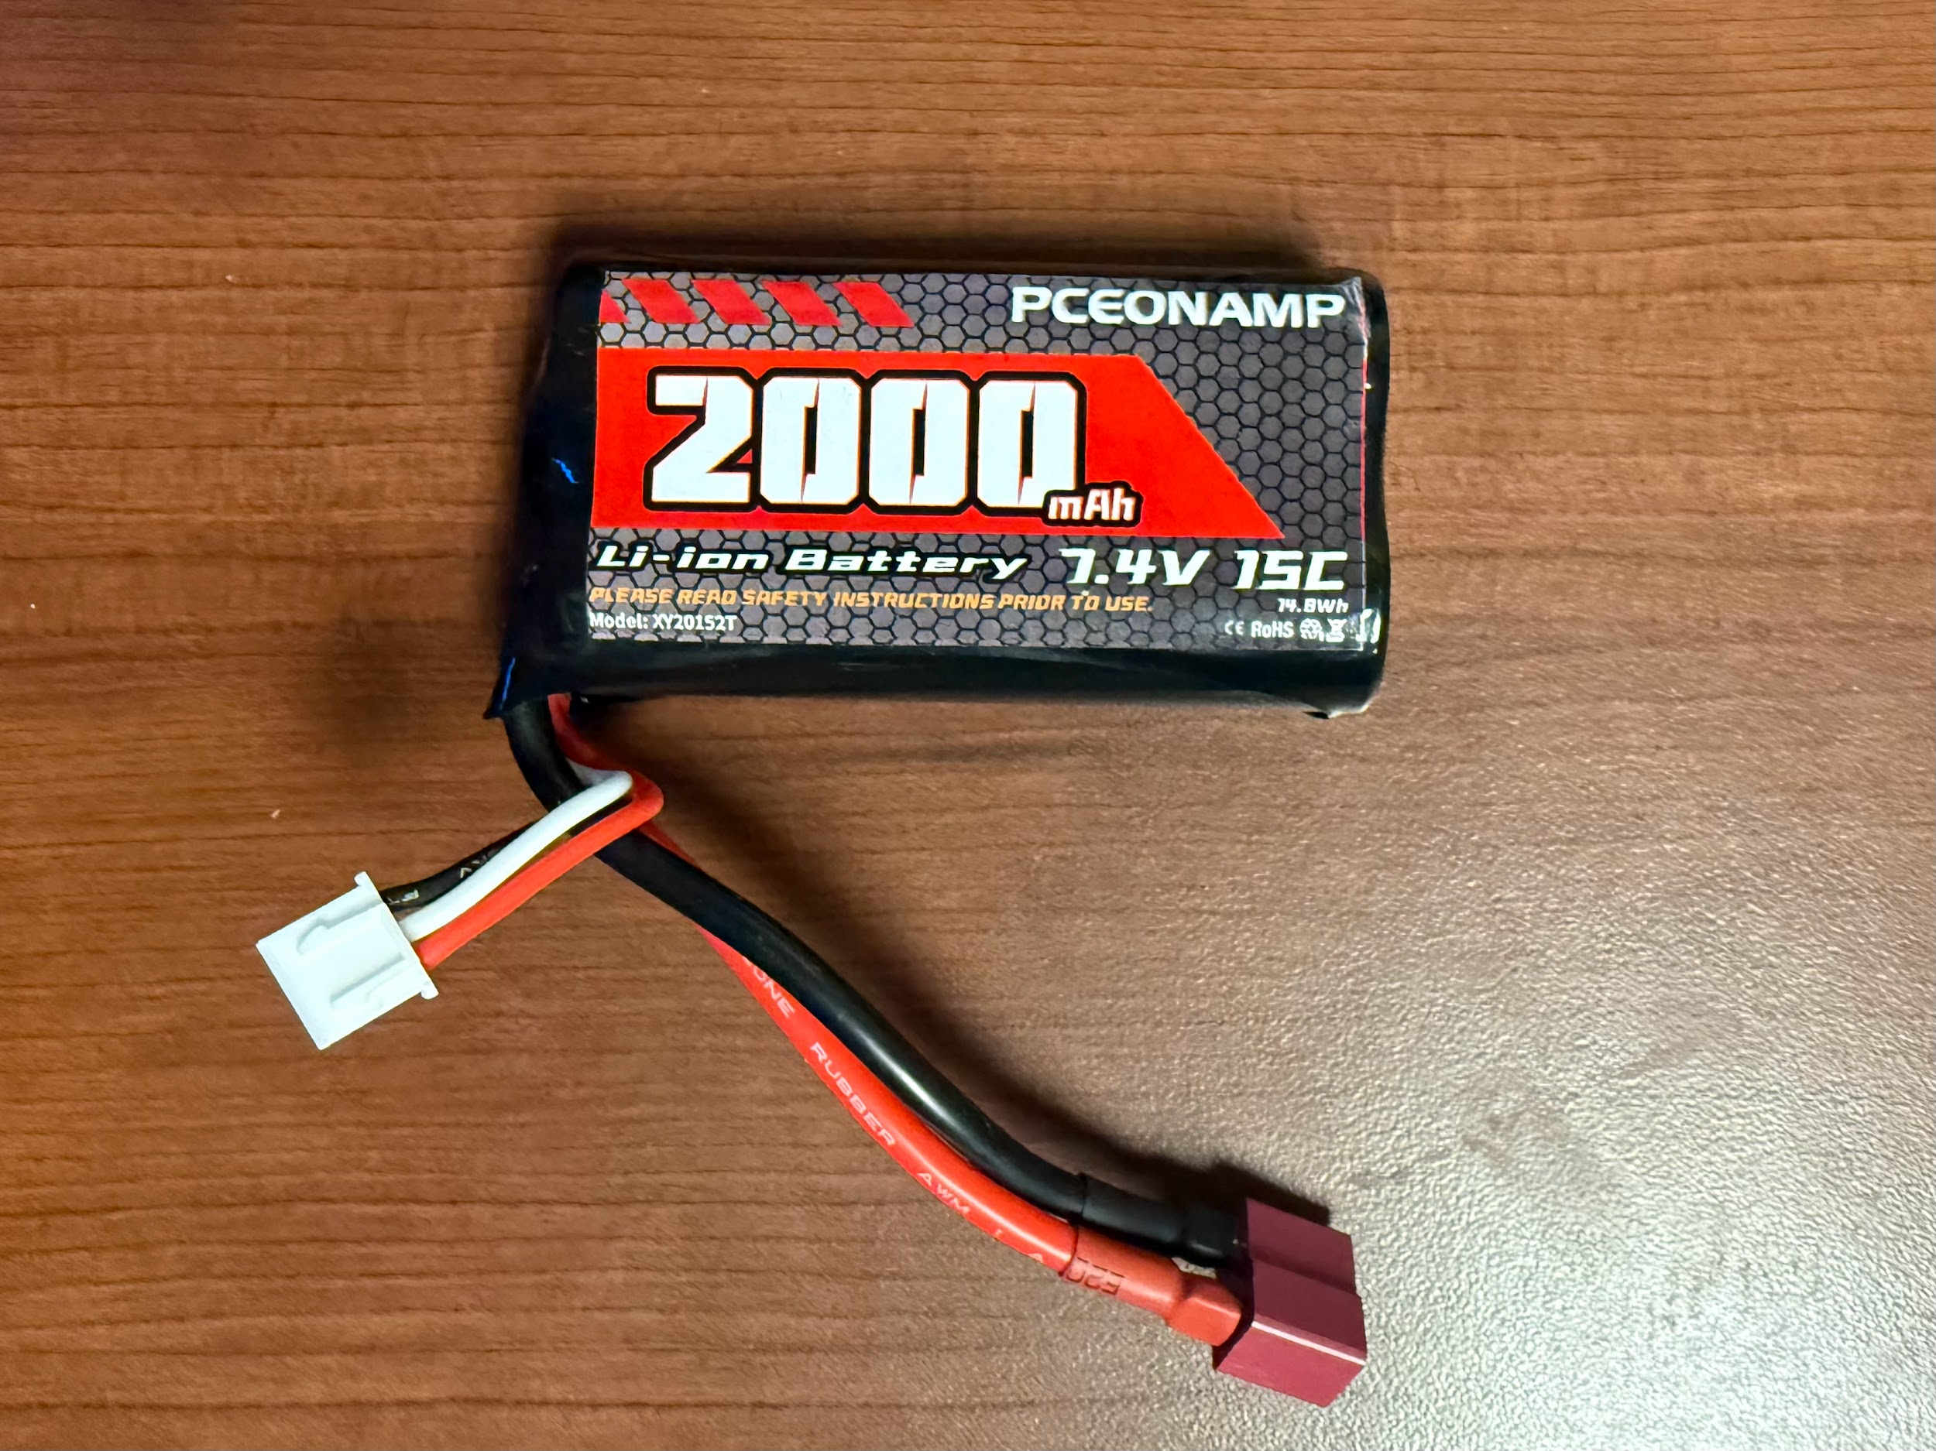
Components Used (3)
MG995 Servo Control
Matthew already had some on hand.
High speed/snappiness is great for quick motions of the NERF blaster.
https://a.co/d/ikl2Bn1
Pceonamp Li-ion Battery
Used to power the Pi 5, the servos, and the chassis.
Our team already had access to some of these.
Notes:
Matthew

Slide 6
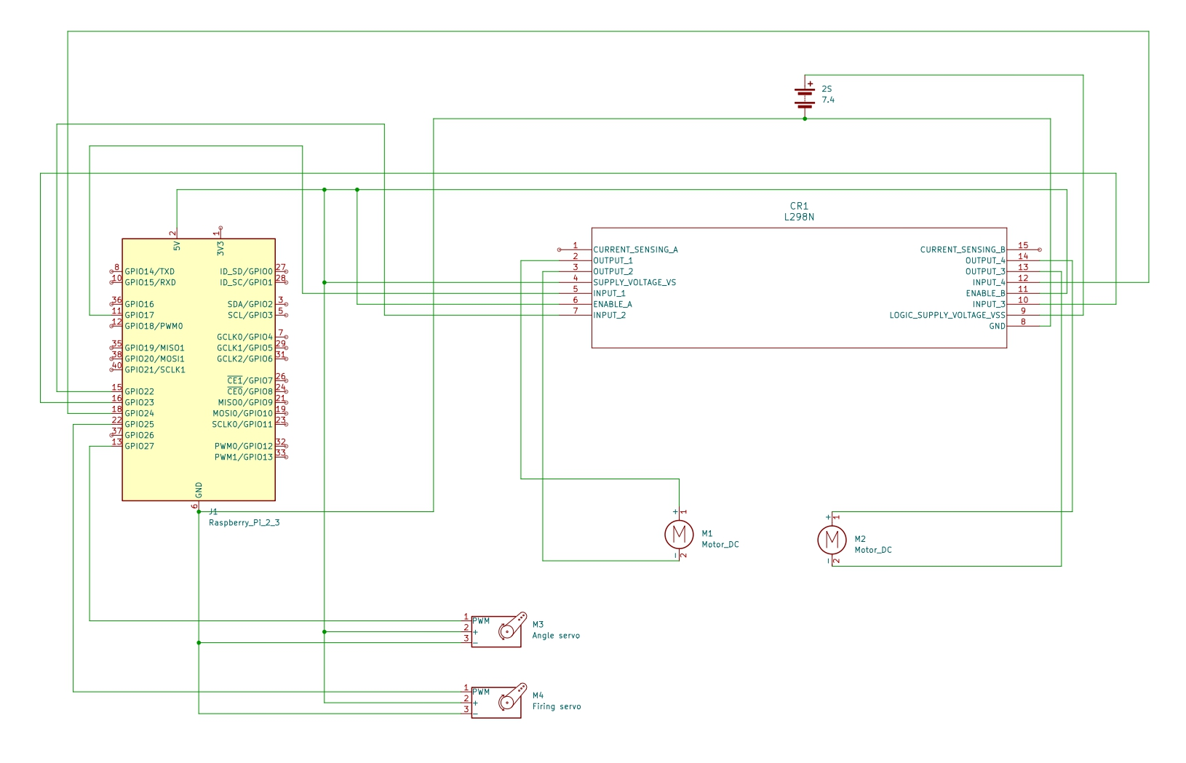
Electronics
2S LiPo
Raspberry Pi powered over 5V pin
Internal power regulator of L298N H Bridge
Notes:
Sam

Slide 7
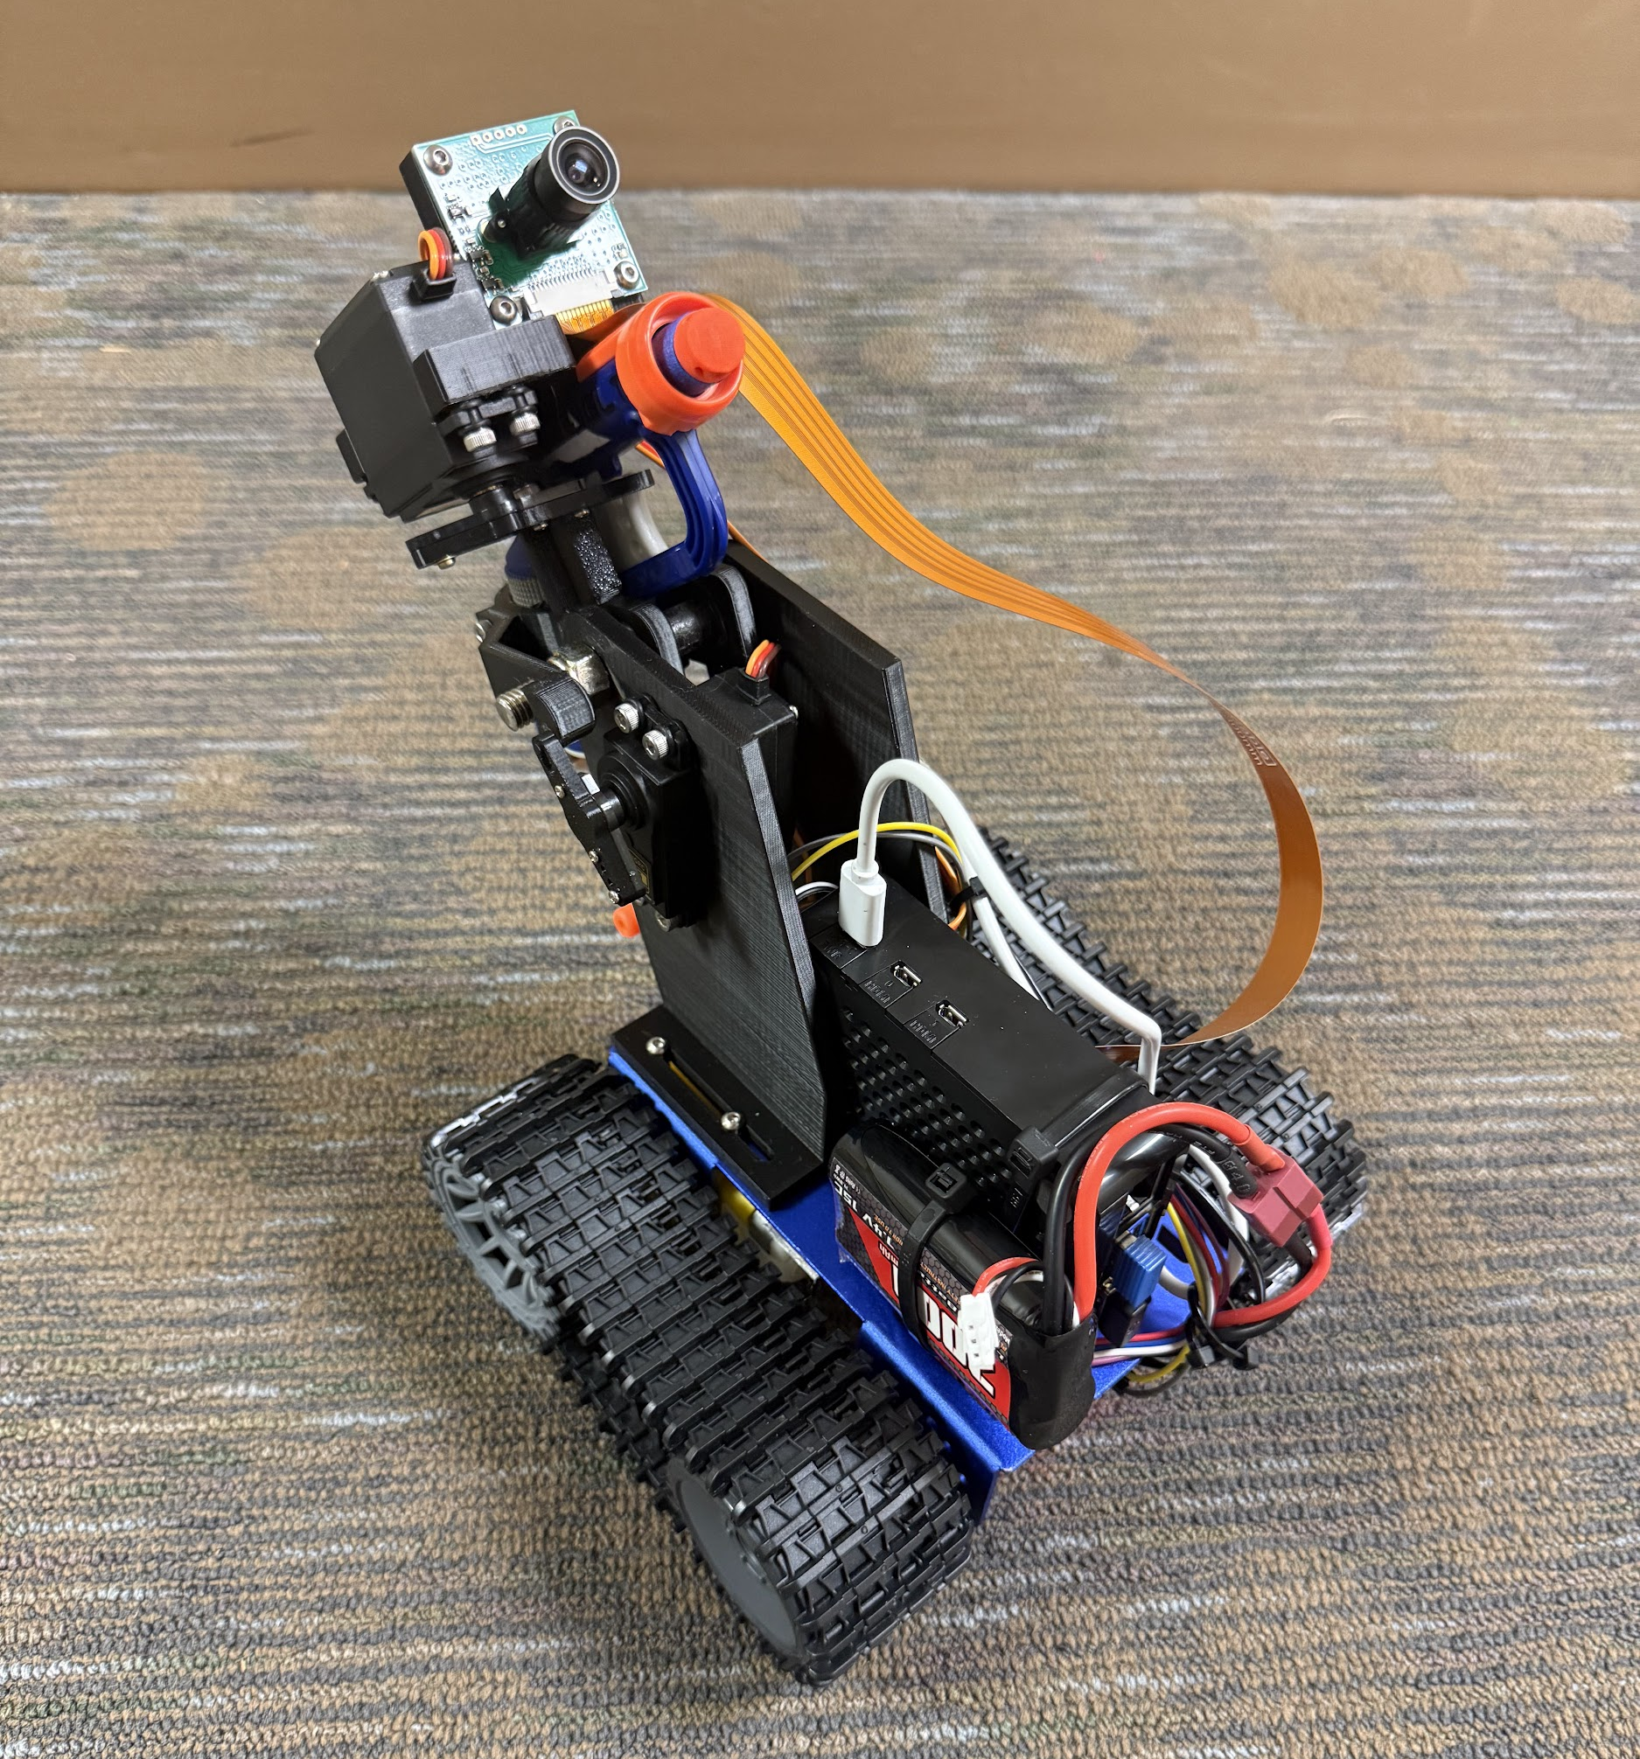
The system
Camera module
Servos for firing the blaster
The NERF blaster
Camera cable
Servo for moving the blaster up/down
3D-Printed component to hold the blaster, servos, & Pi.
Raspberry Pi 5.
Battery
Chassis and treads.
Notes:
Matthew

Slide 8
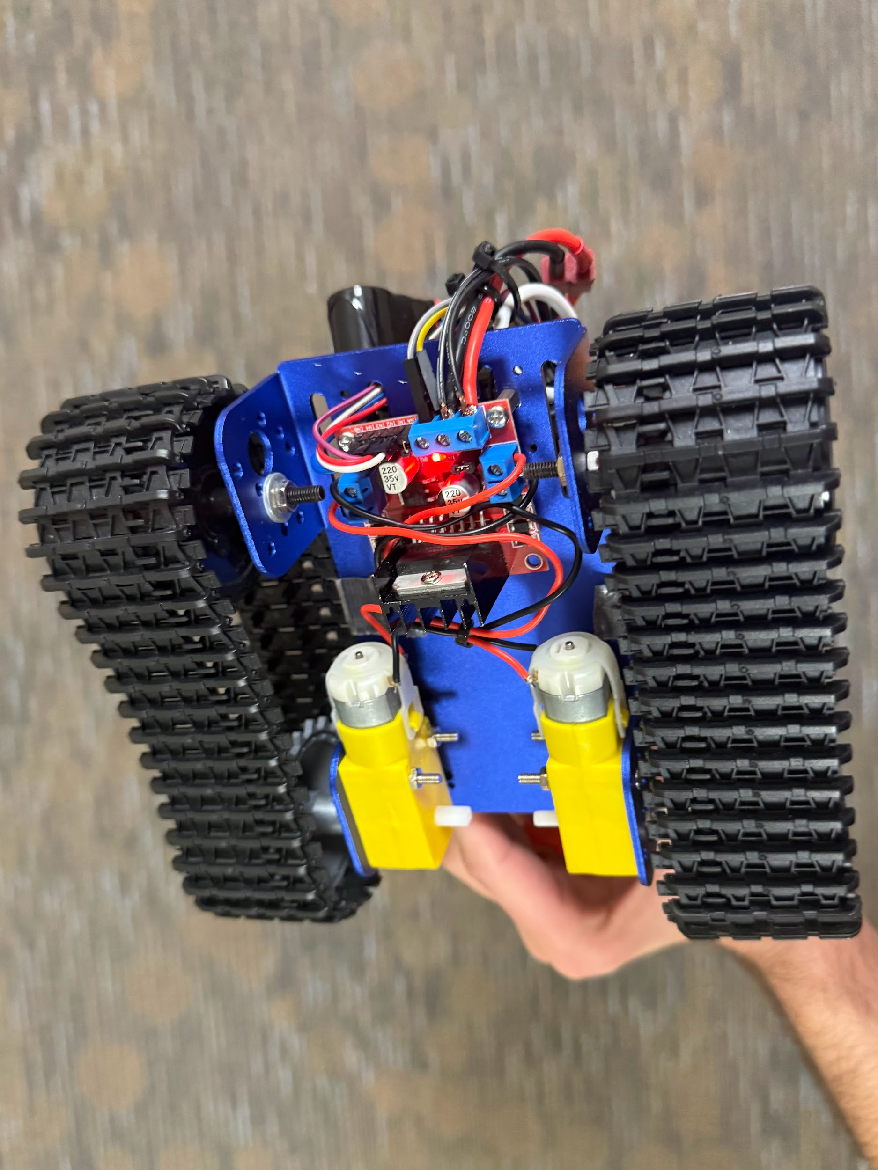
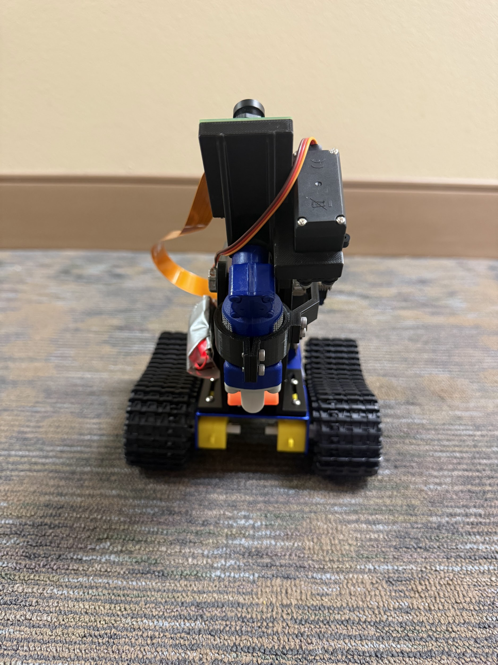
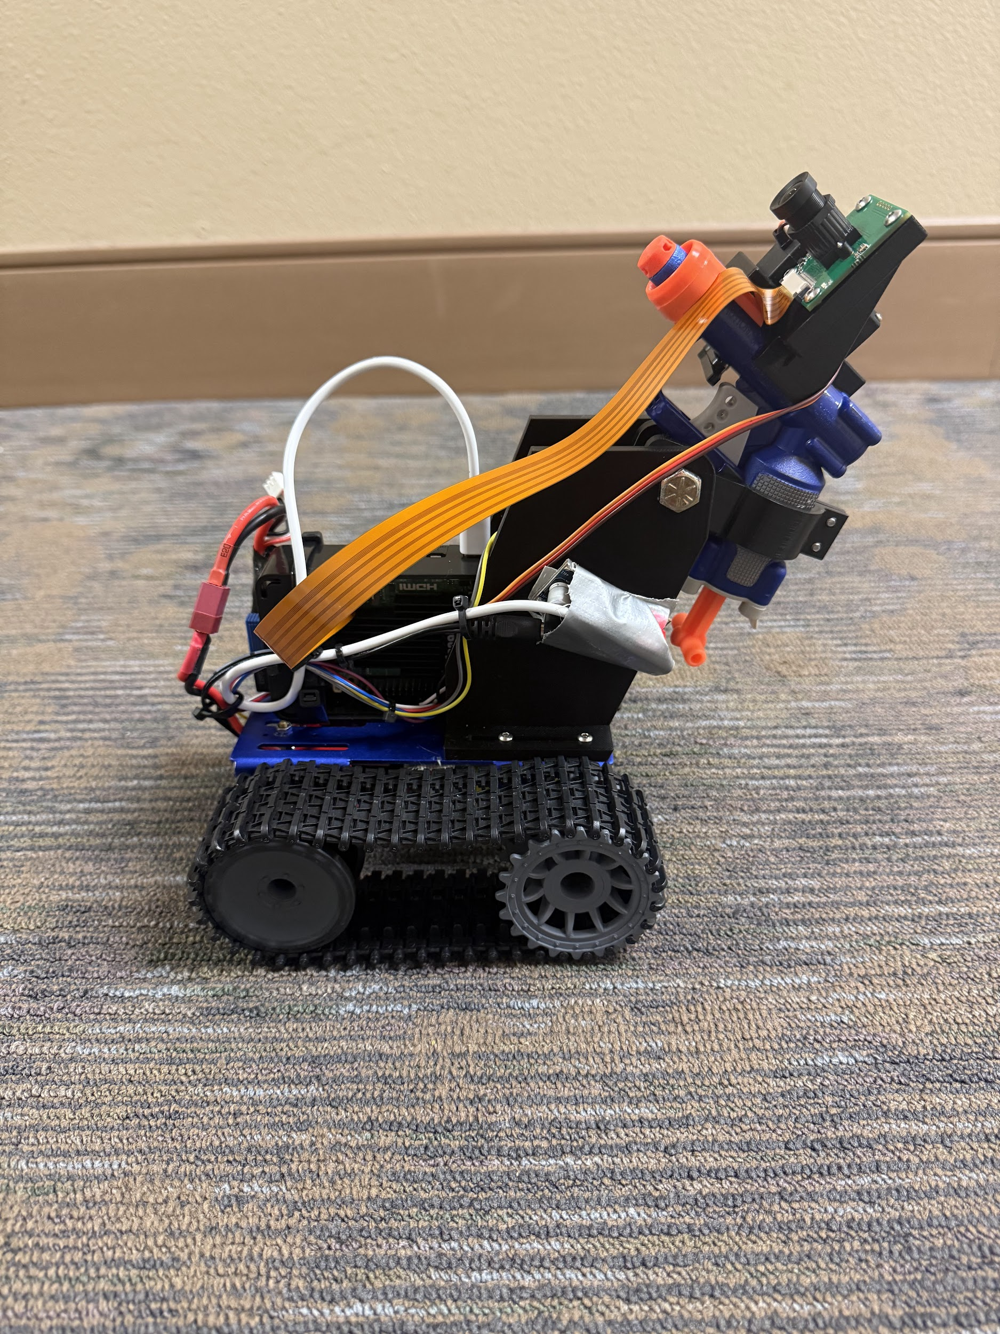
The system (additional views)
Notes:
Sam

Slide 9
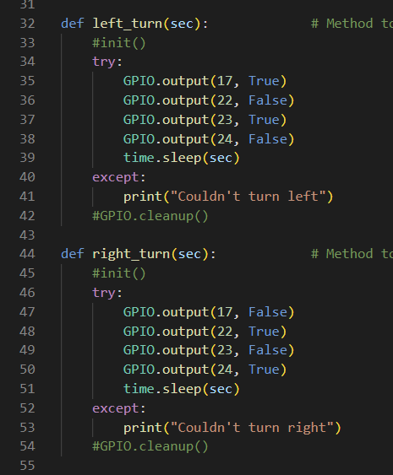
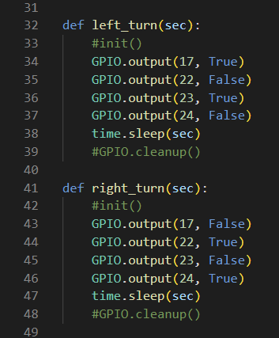
Movement
Simple dual H-Bridge circuit.
Using High and Low signals to control the motor going clockwise and counterclockwise .
PWM for servos.
Originally, each method for turning the chassis has GPIO initialization and cleanup, but that conflicted with other GPIO processes.
Movement methods called using several small increments.
Notes:
Jared

Slide 10
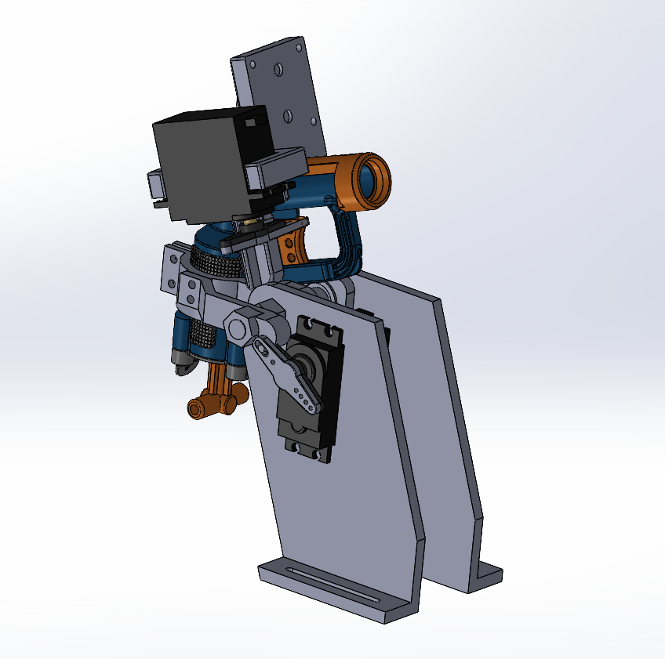
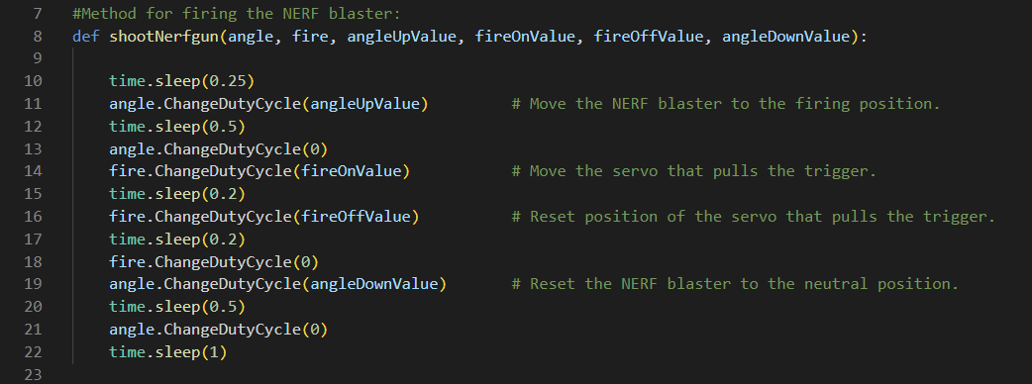
Shooting the NERF Dart
Blaster has to be cocked manually
12, 3D printed components
Servos used to adjust the blasters height and pull the trigger
Used simple PWM control to aim and fire the blaster
Notes:
Matthew

Slide 11

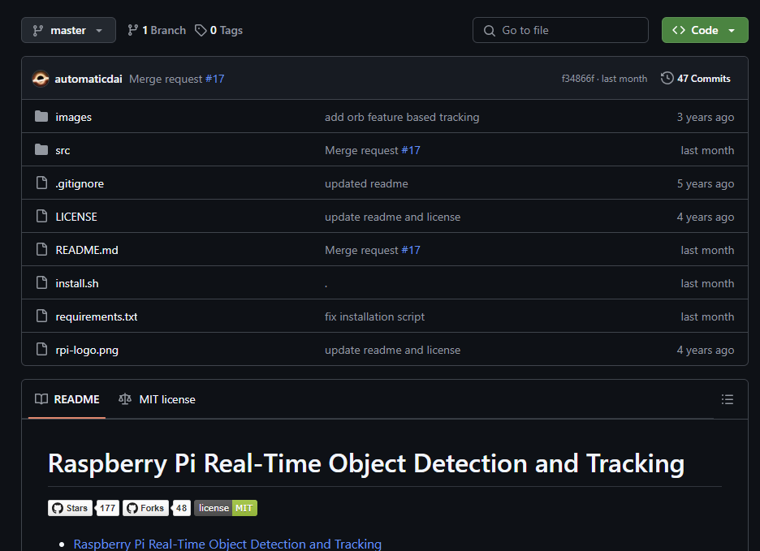
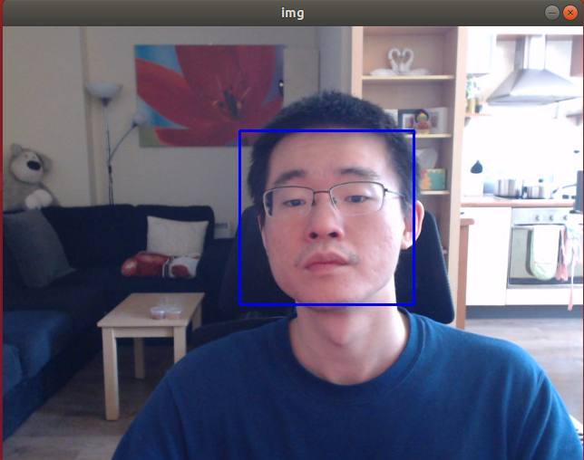
Face Tracking
OpenCV library used.
Used face tracking code by automaticdai on GitHub as a starting point.
The borrowed code displays a window and draws a blue box around any detected faces.
Link: https://github.com/automaticdai/rpi-object-detection?tab=readme-ov-file#31-camera-test
Notes:
Jared

Slide 12
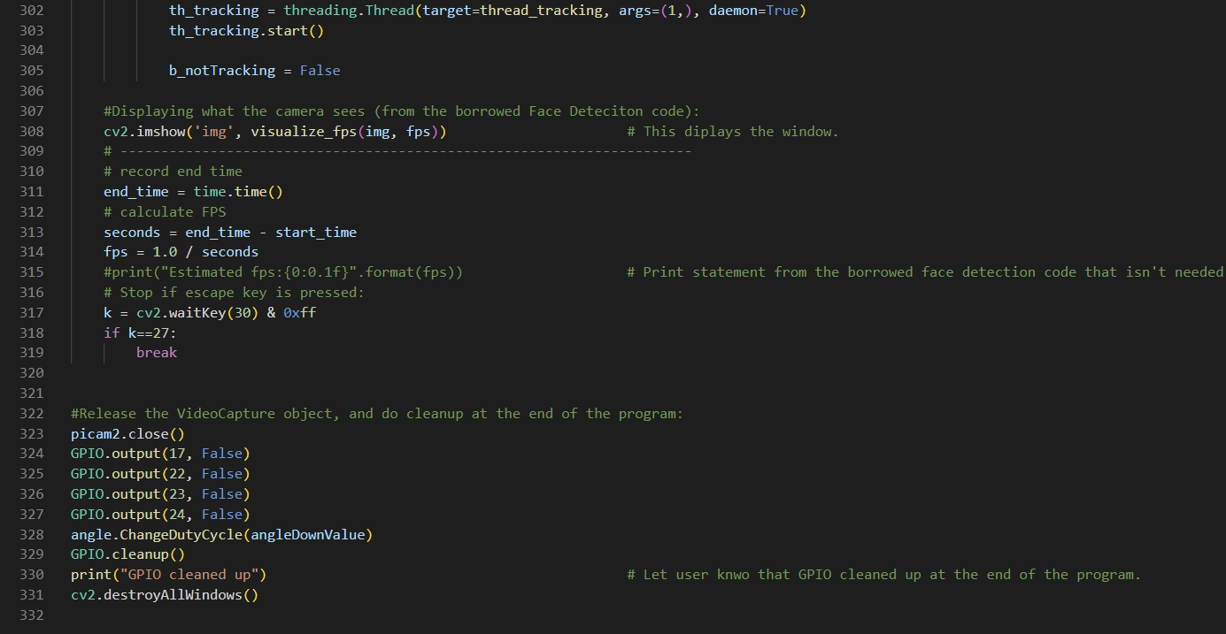
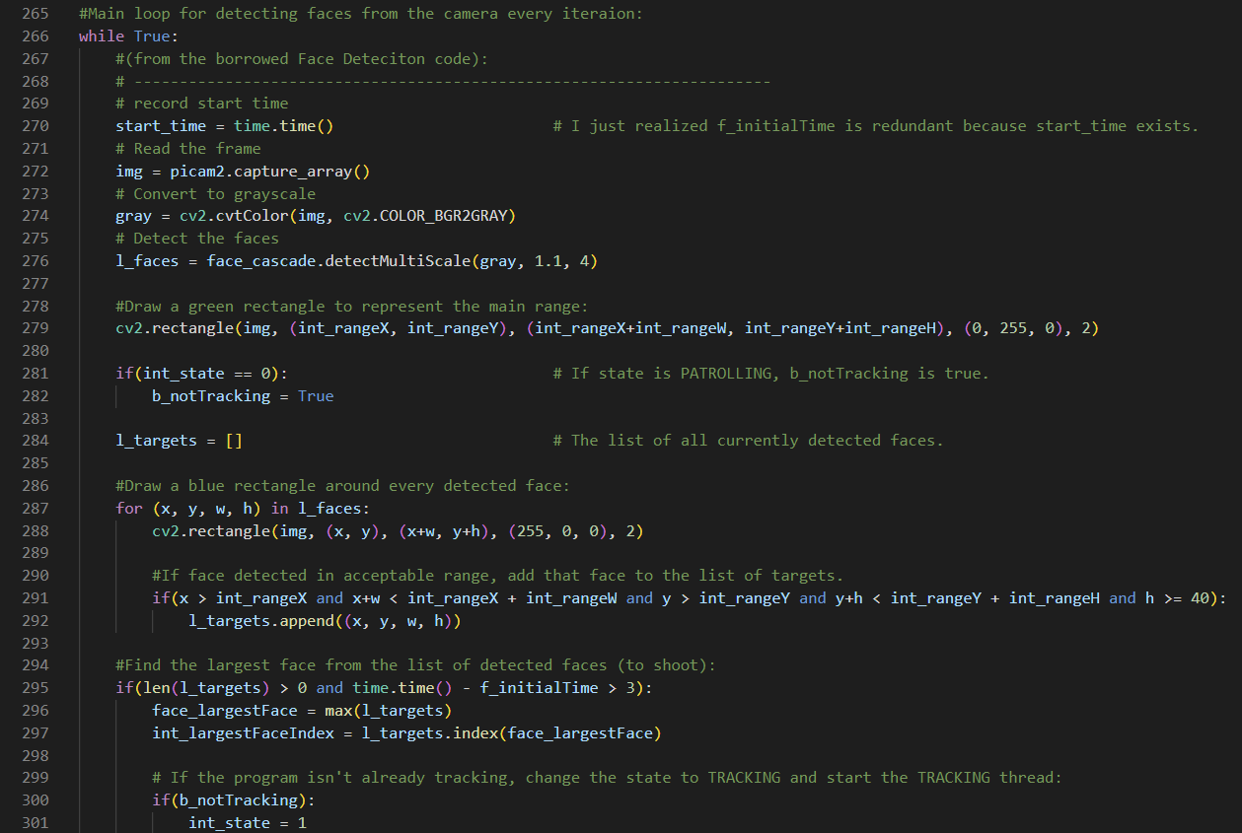
The code (Main Loop)
If a face is within the valid range, add it to the list of potential targets.
The largest target is selected to be shot by the blaster (indicated by a red box instead of blue).
If a largest target exists, change int_state to 1 and start the Tracking thread.
Notes:
Jared

Slide 13
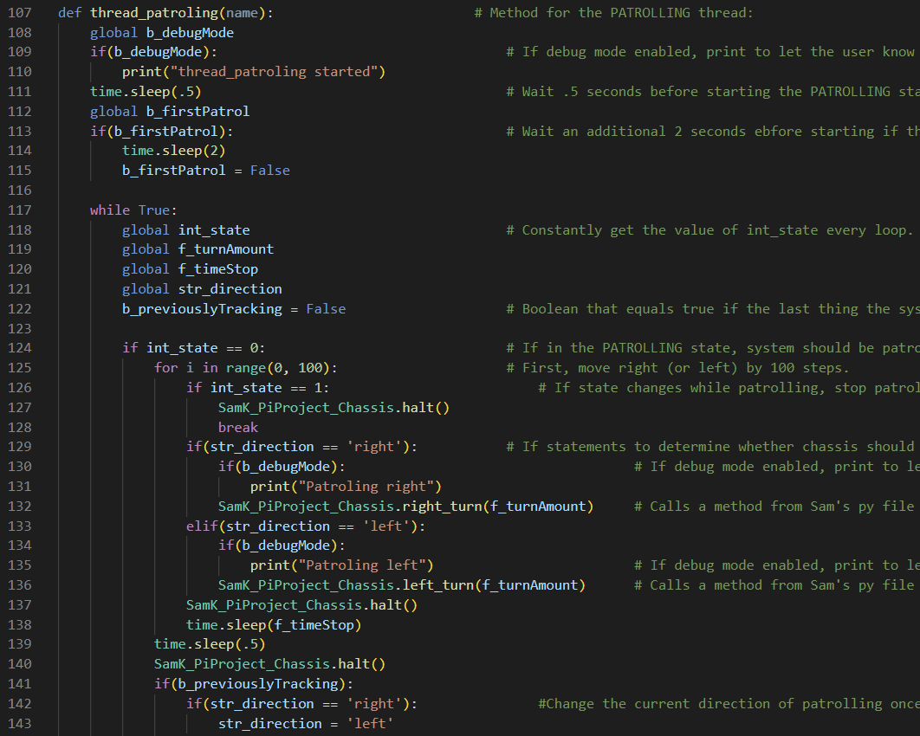

The code (Patrolling Thread)
If a face isn’t detected, the system is in a patrolling state.
This is done by the Patrolling Thread, which causes the system to alternate between moving left or right as long as int_state = 0.
This thread doesn’t do anything if int_state = 1.
Notes:
Jared

Slide 14
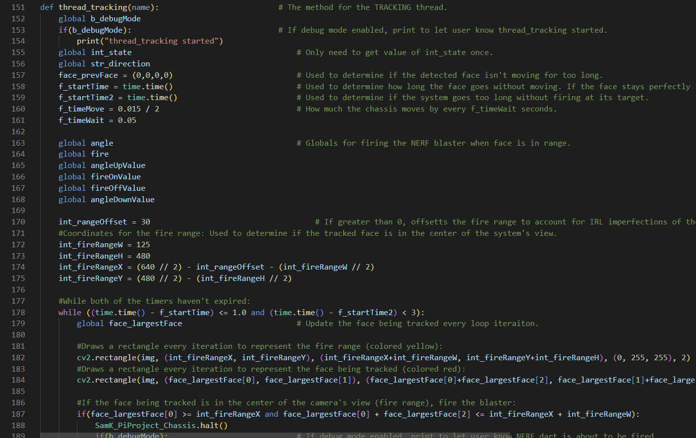
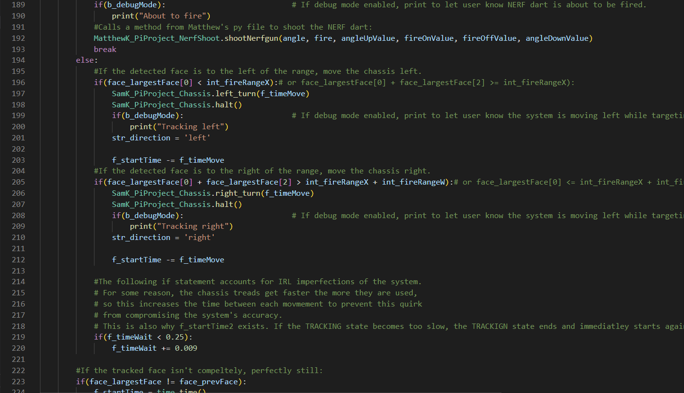
The code (Tracking Thread)
If the targeted face is to the left of the center of the view, move the chassis left until the targeted face is centered.
The same applies to if a face is to the right of the center.
When the targeted face is in the center, use the servos to fire the NERF blaster.
Notes:
Jared

Slide 15
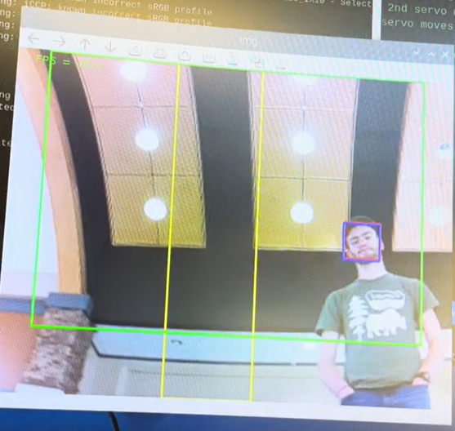
The Tracking Thread (cont.)
The yellow box represents the center of the camera.
Isn’t perfectly centered to account for the fact that the NERF blaster isn’t perfectly straight.
Notes:
Jared

Slide 16



Challenges
Powering the Raspberry Pi not using the computer so the rover can run autonomously.
Providing enough power to all the components.
Achieved with the Pceonamp 2000 mAH Li-ion Battery (7.4V, 15C).
Battery running out was sometimes an issue.
Getting smooth motion from the chassis was a challenge. Had to rapidly move in small increments with fraction-second wait times between movements.
Didn’t find a way to have the system move forward on its own in time.
Working with threading for the first time proved a challenge. Overcome by figuring out how/when to use global variables to get threads to function as intended.
Notes:
Sam

Slide 17
New Experiences Gained
Jared
Working with threading and making sure multiple processes don’t conflict with each other.
Getting a program to reference other programs.
Programming code that uses a Raspberry Pi camera module.
Working with face tracking code.
Matthew
Working with PWM to control servos.
Figuring out how to power the whole system.
Learned more about face tracking.
Sam
Using H-Bridges for motor control.
Power management of the chassis.
Managing the confined space of components when constructing the system.
Notes:
(all of us)

Slide 18
Final Thoughts and Improvements
Conclusion/What we achieved:
Project was a success
System can autonomously track and fire
System is able to aim itself
Things we could improve:
Web application to control rover over internet and live stream camera feed
Ultrasound or infrared sensors for positioning, autonomous patrol around the house, better targeting
PID controller for smoother driving
Notes:
Sam

Slide 19

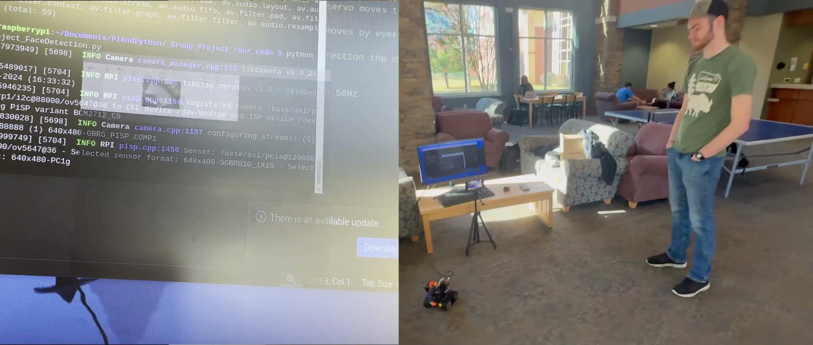
Video Demonstration

Slide 20
Questions?
Notes:
Jared

Slide 21
Thank you
Notes:
Jared

